Slide 1

Blazor La rivoluzione di Blazor C# running in the browser via WebAssembly
Giampaolo TUCCI

Slide 2
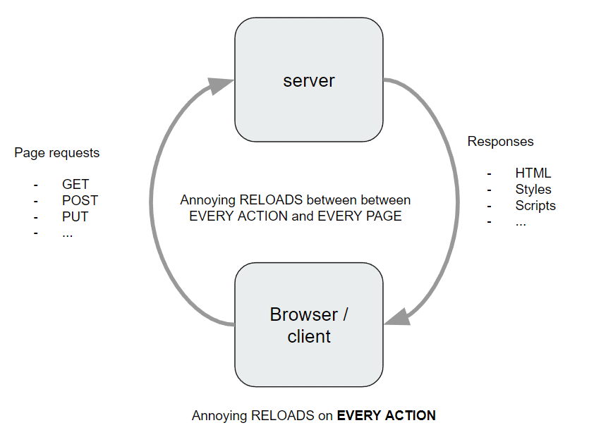
Breve storia delle web-app
Modello round-trip o Multi Page Application

Slide 3
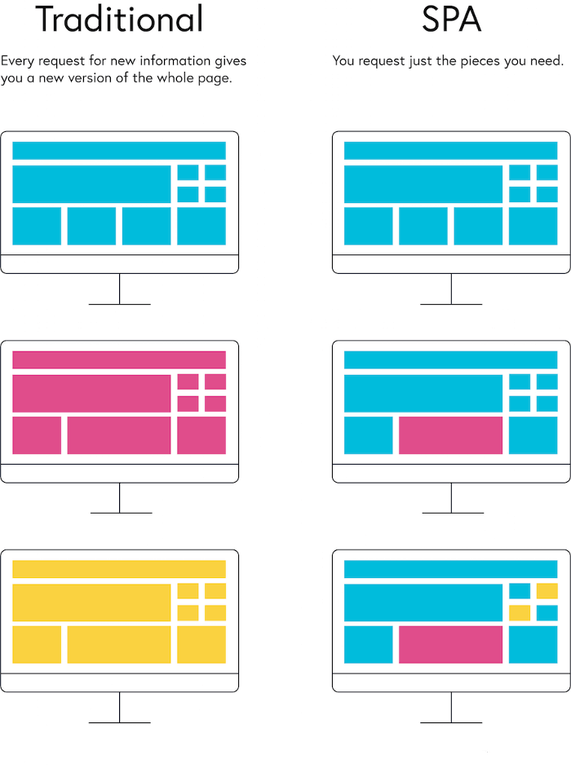
Il “nuovo”: le single page application SPA

Slide 4
Problems
Whole host of people don’t like JS
Dynamically typed
Less integration, more stitching
Browser support
Moves too fast, lots of choice, intimidating
SPA’s are more expensive to maintain
Front-end + Back-end team
Training up full stack to be great at both (very difficult)
When using a different language than JS on the backend…
Duplicate Business Logic (like validation) or just have server
No IDE/compiler help between backend models + front end making AJAX calls
Unless bringing in yet another tool

Slide 5
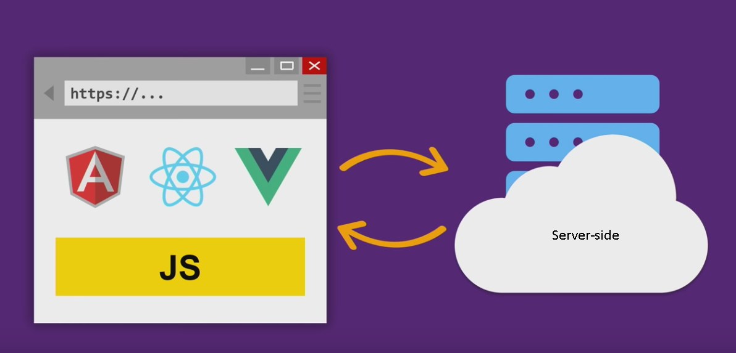

Slide 6

Il nuovo arrivato: WebAssembly

Slide 7
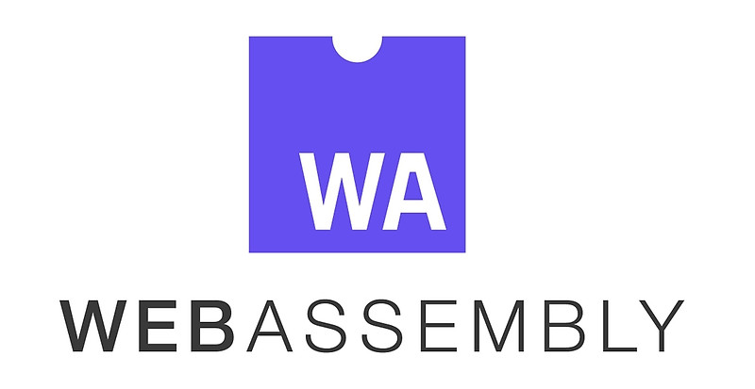
Il nuovo arrivato: WebAssembly
WebAssembly (WASM) is a low-level binary format language that can be run in modern web browsers that runs at near-native speeds.
Compilation Target for other languages
Browser standard
No more JS monopoly

Slide 8
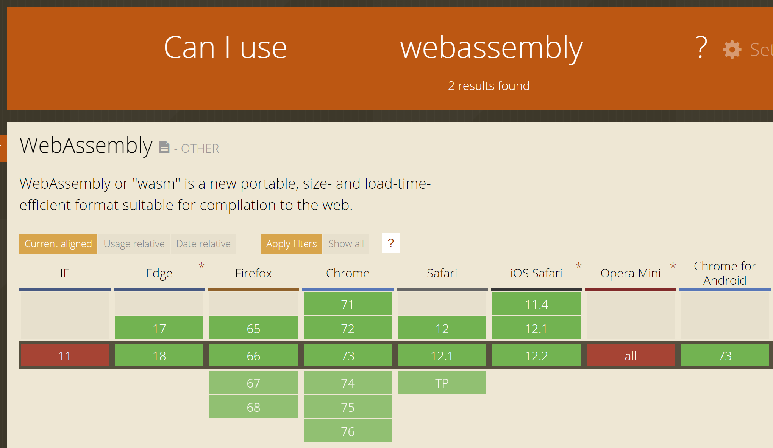
Is WASM Ready?
…….and you can polyfill WASM !

Slide 9
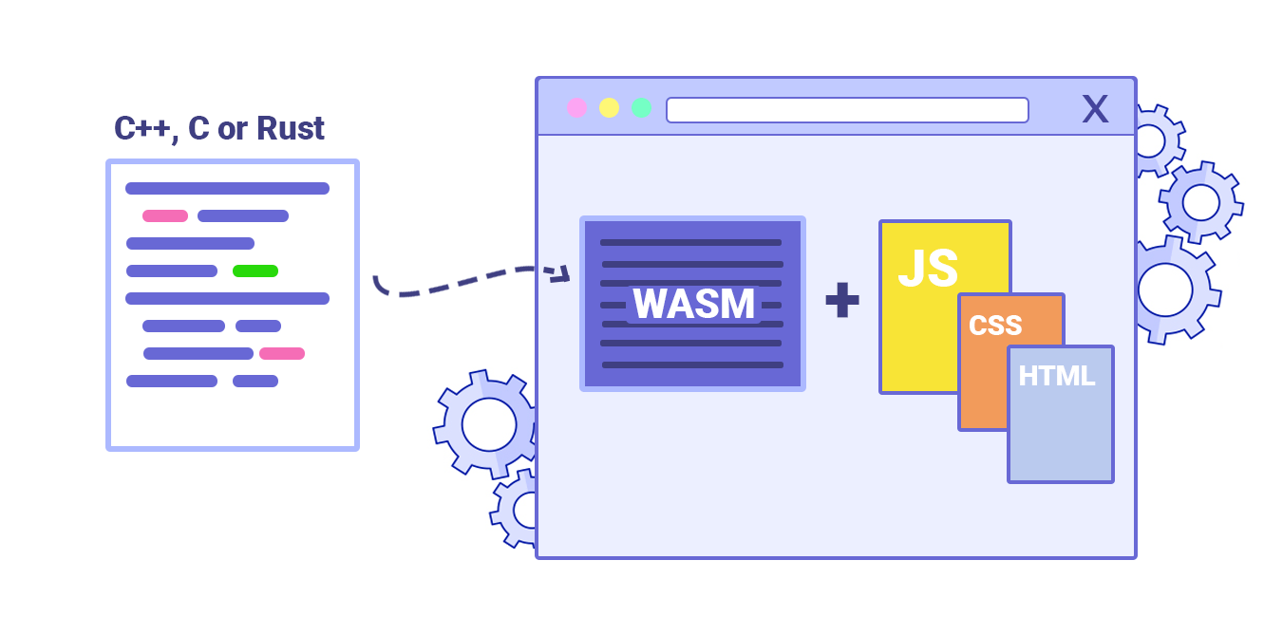

Slide 10
What is Blazor?
Blazor is a .NET SPA framework (currently in Preview) maintained by Microsoft using C# and HTML that runs in the browser via WebAssembly….
Uses Razor syntax
Browser + L + Razor = Blazor
Uses component-based architecture
Runs on top of Mono
Blazor == UI Framework == MVC or Web Forms
Mono == Runtime == .NET Framework or .NET Core
Development led by Steve Sanderson, of KnockoutJS fame

Slide 11
Was Experimental – Now Committed & Preview
“... With this newest Blazor release we’re pleased to announce that Blazor is now in official preview! Blazor is no longer experimental and we are committing to ship it as a supported web UI framework including support for running client-side in the browser on WebAssembly…”
.NET Core 3.0 Preview 4 announcement

Slide 12
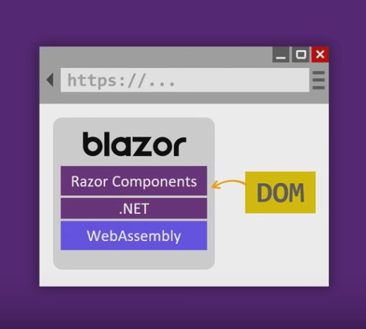
Browser + Razor = Blazor!

Slide 13

So I can write C# in the Browser!?!
Blazor is .NET Standard 2 compliant
However, not all .NET Standard 2 API’s are implemented running in browser make sense
Examples
System.Net.Mail
System.IO
These throw Platform Not Supported exceptions
But a lot do make sense
HttpClient => AJAX

Slide 14
Blazor Provides Calling C# from JS + vice versa
C# Wrappers on top of JS API’s
LocalStorage
PaymentRequest
Or any npm library
C# maps to JS pretty well
async/await
Task => Promise

Slide 15
Con Blazor è possible…
Scrivere logica client che interagisce con la UI della web-app usando .Net/C# in luogo di javascript
Il framework favorisce il riutilizzo del codice
Utilizzo di “components”
Condividere codice lato client e lato server (esempio: POCO class)
Può riutilizzare molte librerie scritte per .Net standard
Interagisce perfettamente con javascript (Javascript Interop)
E’ possibile richiamare funzioni javascript da codice Blazor C#
Da codice javascript è possible utilizzare classi Blazor/C#

Slide 16


Slide 17
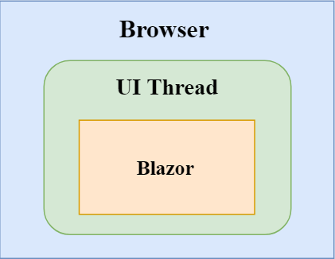
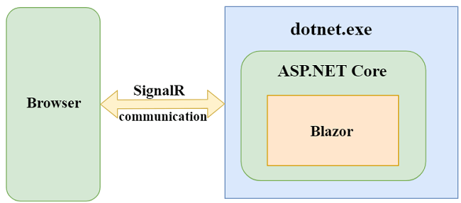
Blazor WA vs Server-Side

Slide 18
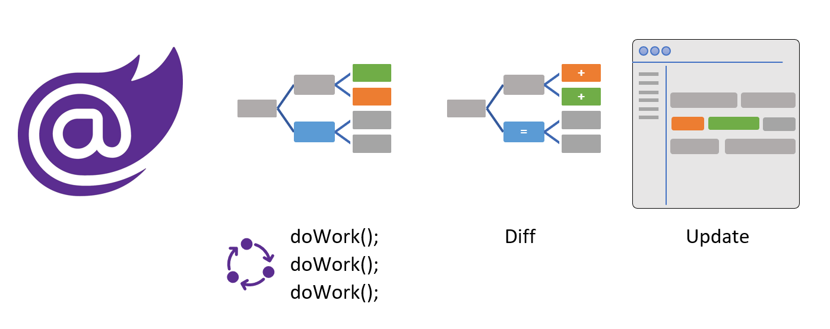

Slide 19

Server-Side vs Blazor Web Assembly
Pros
Migliore compatibilità con browser poichè al client NON arriva WASM (IE 11 funziona !)
Migliore possibilità di debug (ad oggi per client-side sono limitate)
Accesso complete all’ecosistema .NET (utilizzo completo delle librerie .NET, tool di debug avanzati)
Il download iniziale della app è molto minore rispetto al client-side (che deve per forza scaricare ad esempio mono.wasm)
Cons
Latenza: sicome il rendering della pagina avviene lato server e quindi inviata al client (seppur in modo ottimizata grazie a SignalR) esiste la latenza di rete.
Scalabilità: dipende dal server.

Slide 20

Routing
E’ la tecnica per ispezionare l’URL richiesto dall’utilizzatore e associarlo alla pagina Blazor da restituire.
Una pagina è un Blazor componente dotato di una route per poterla raggiungere !

Slide 21
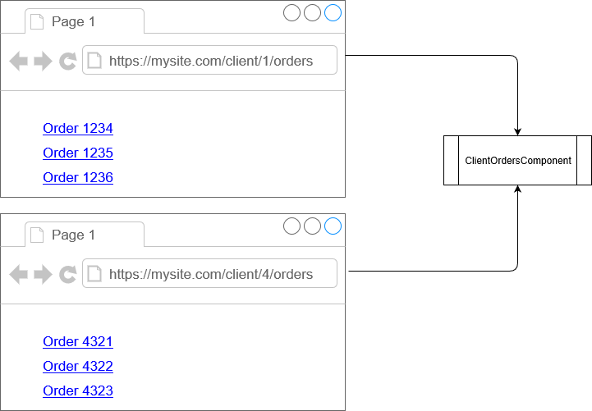
Blazor Routing
@page "/clients"
@page "/clients/{CustomerId}/orders"
<h1>
Customer:
@if (string.IsNullOrEmpty(CustomerId))
{
@:None
}
else
{
@CustomerId
}
</h1>
@code {
[Parameter]
public string CustomerId { get; set; }
}

Slide 22

Demo
Server-Side

Slide 23
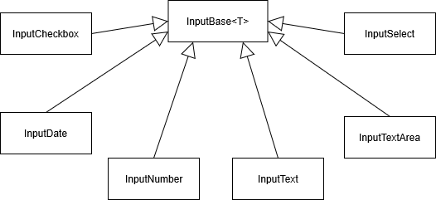

Slide 24

Pros & Cons
Pros
Migliore compatibilità con browser poichè al client NON arriva WASM (IE 11 funziona !)
Migliore possibilità di debug (ad oggi per client-side sono limitate)
Accesso complete all’ecosistema .NET (utilizzo completo delle librerie .NET, tool di debug avanzati)
Il download iniziale della app è molto minore rispetto al client-side (che deve per forza scaricare ad esempio mono.wasm)
Cons
Latenza: sicome il rendering della pagina avviene lato server e quindi inviata al client (seppur in modo ottimizata grazie a SignalR) esiste la latenza di rete.
Scalabilità: dipende dal server.

Slide 25

Autenticazione vs Autorizzazione
L’autenticazione è il processo che permette di identificare l’utilizzatore in modo sicuro.
Questo processo nel passato veniva svolto tramite l’ausilio di una userid e una password: il concetto che sottende questa attività è che solo chi conosce la relativa password è in grado di sostenere di essere realmente l’utente specificato.
Ora i sistemi più moderni dovrebbero supportare un processo diverso, chiamato OAuth, che utilizza attori esterni nel processo di autenticazione.
Il termine autorizzazione indica invece in generale il permesso o la facoltà di compiere determinate azioni: nel nostro caso che tipo di dati posso scaricare come offline sync e posso modificare.
Notes:
25

Slide 26

Client-Side vs Server-Side

Slide 27

Agenda
What is WebAssembly?
What is Blazor?
How does Blazor work?
Demos
Questions
scottsauber

Slide 28
Purpose
Differentiate what is Blazor vs WebAssembly
Get excited for the future
scottsauber

Slide 29
Who am I?
Software Consultant at Lean TECHniques
.NET/JS Developer
React fanboy
Actually enjoys JavaScript
Blog primarily on ASP.NET Core on scottsauber.com
Author of Blazor Snippets for VS Code
scottsauber

Slide 30
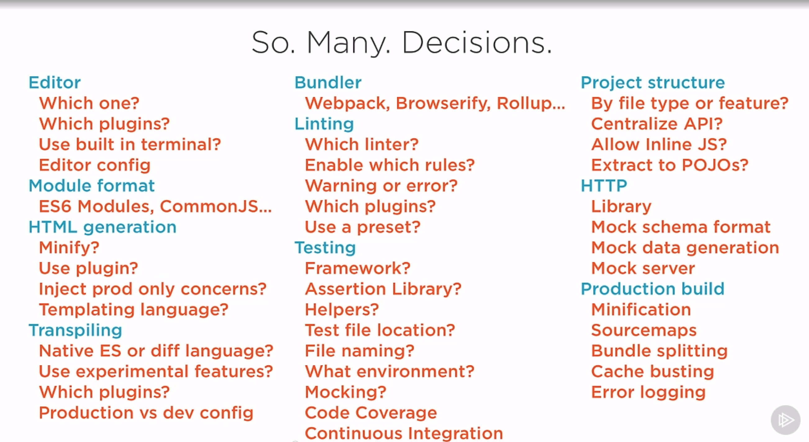
Source: Cory House’s Building a JavaScript Development Environment Pluralsight course

Slide 31

At the end of the day….

Slide 32
Why would you be interested in this?
C# is a fantastic language
…not that JavaScript isn’t…but statically typed languages are winning (see: TS, Flow, Reason, etc.)
46% of respondents to npm survey are using TypeScript
ASP.NET Core performance
#7 on TechEmpower
8x faster than Node, 1.5x faster than Netty (Java), 47x faster than Django (Python), 7x faster than Kotlin, etc.
Share logic with existing .NET backend
Validation logic
Models from Server when retrieve from the Client
Consolidate frontend and backend teams under one language

Slide 33
Demo #1
Hello World on Blazor
Component Architecture
Dependency Injection
Sharing logic
scottsauber

Slide 34
Rapid Fire Questions
How big is it?
2.4MB
Very little work done thus far to optimize
Do WASM files cache like JS and CSS files?
Yes
How does it work under the hood?

Slide 35
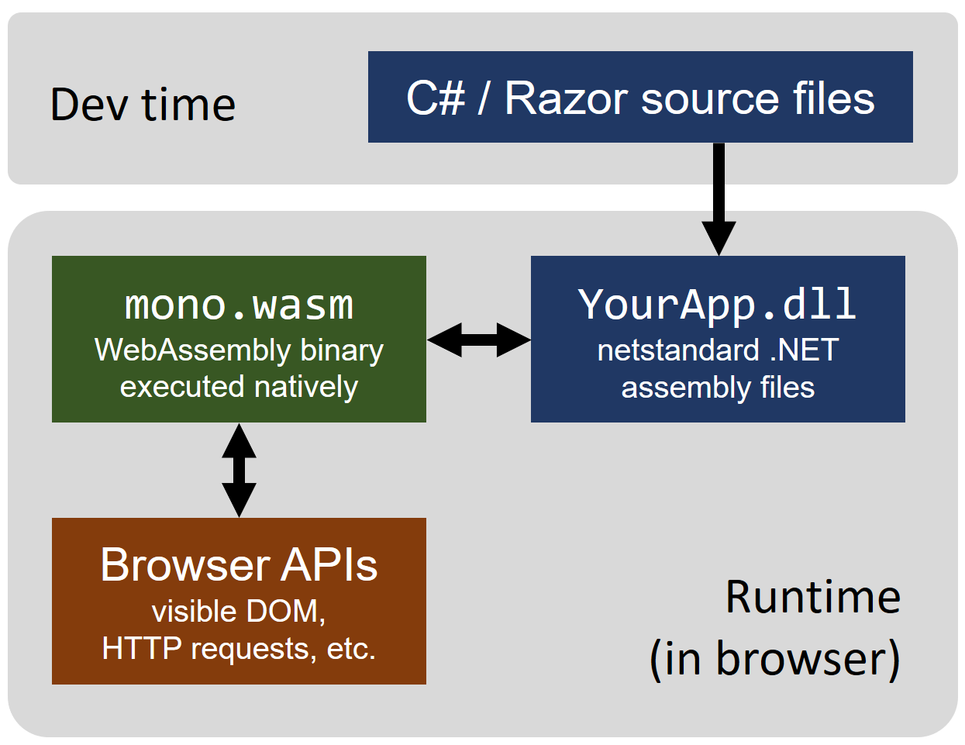
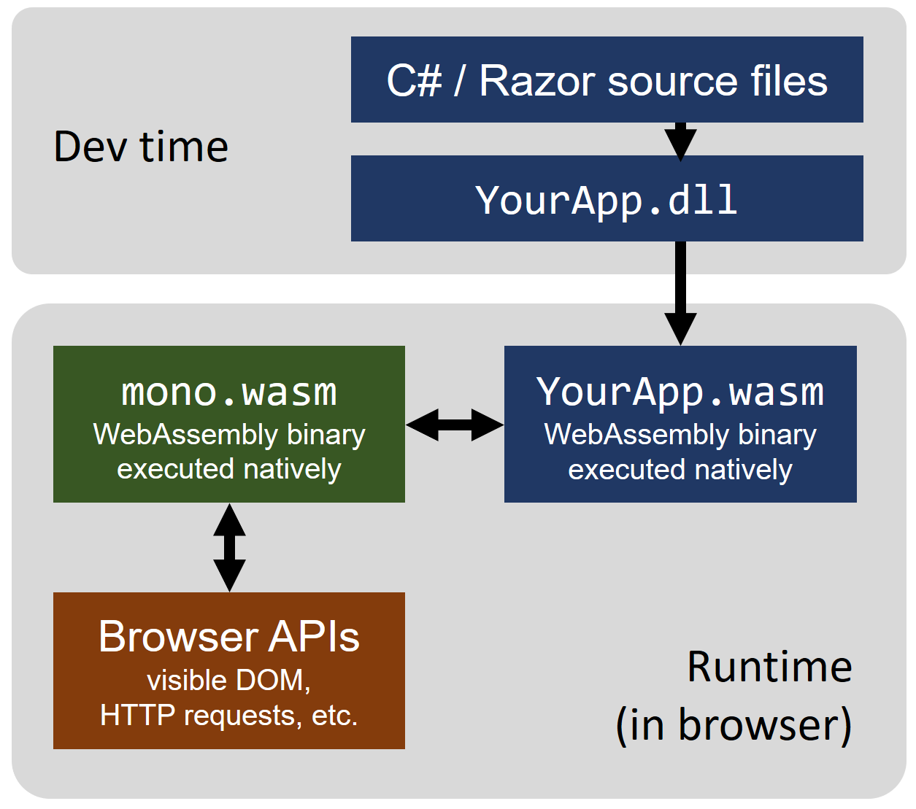
How does Blazor work?
Today
Future
Source

Slide 36
Why Mono? Why not .NET Core?
Already Client-side-focused
Xamarin, Unity, etc.
.NET Core is Server-side-focused
Already developed for unique platforms (iOS, watchOS, PS4, etc.)
Already had linker (DLL trimmer/tree shaker) for Xamarin
They got it working first
Long term they want to consolidate on .NET Core
scottsauber

Slide 37
Demo #2
LocalStorage C# Wrapper
Code: https://github.com/scottsauber/BlazorToDoMVC
scottsauber
Notes:
Install Cloudcrate.AspNetCore.Blazor.Browser.Storage
services.AddStorage(); @inject LocalStorage Storage

Slide 38
What else can we do?
Blazor’s component model is de-coupled from the Browser
…so…

Slide 39
What else can we do?
Blazor on Electron
Cross-platform desktop framework. Write once, run anywhere.
Proof of Concept Running on .NET Core
Why?
Faster Code Execution
Full Debugger in VS
.NET Core instead of Mono
Access to Desktop API’s

Slide 40
Demo #3
Blazor on Electron
Electron.App
Code: https://github.com/SteveSandersonMS/BlazorElectronExperiment.Sample
scottsauber

Slide 41
What else can we do?
Blazor on the Server
Feels client-side
Changes streamed via WebSocket
Why?
Small bundle (~400KB)
Code runs on .NET Core server, no constraints
Full Debugger in VS
Why not?
More load on server
Does not support disconnects

Slide 42
Demo #4
Blazor on the Server
scottsauber

Slide 43
Blazor 3rd party Components
Telerik
Syncfusion
DevExpress

Slide 44
Current Status - What’s there?
Component Model
Routing
Layouts
Dependency Injection
JS interop
Share Components between projects
Debugging in Chrome – Shift + ALT + D
Forms and Validation
VS and some VS Code support
Blazor Server-Side
Server Side Rendering

Slide 45
Current Status - What’s coming?
Better tooling
Hot reloading
AOT
Smaller bundle size
AuthN + AuthZ work
Debugging in VS

Slide 46
Future
Currently 3.0 preview4
Client-side Blazor is NO LONGER experimental and will be shipped sometime in the future.
Server-side Blazor will ship with .NET Core 3.0 later this year.

Slide 47
Takeaways
WASM is AWSM
Potential of Blazor
WASM has potential to radically disrupt WebDev
Start thinking about “would this code run ok in the browser?”
Separate domain + input validation

Slide 48
How do I get started?
Today:
.NET Core 3.0 Preview 4 SDK (3.0.100-preview4-011223)
Visual Studio 2019 (Preview 4 or later) with the ASP.NET and web development workload selected.
The latest Blazor extension from the Visual Studio Marketplace.
The Blazor templates on the command-line:
dotnet new -i Microsoft.AspNetCore.Blazor.Templates::3.0.0-preview4-19216-03
Future:
NET Core 3.0+
VS/VSCode/whatever
Slides at scottsauber.com

Slide 49
Resources
https://blazor.net
Microsoft Documentation
https://learn-blazor.net
Community-led Documentation
https://github.com/aspnet/blazor
Blazor Source Code
https://github.com/mbasso/awesome-wasm and https://github.com/appcypher/awesome-wasm-langs
Lists of what other languages are doing with WASM
Slides at scottsauber.com
scottsauber

Slide 50

Questions?
Slides at scottsauber.com
scottsauber

Slide 51
Thanks!
Slides at scottsauber.com
scottsauber

